Slide 1
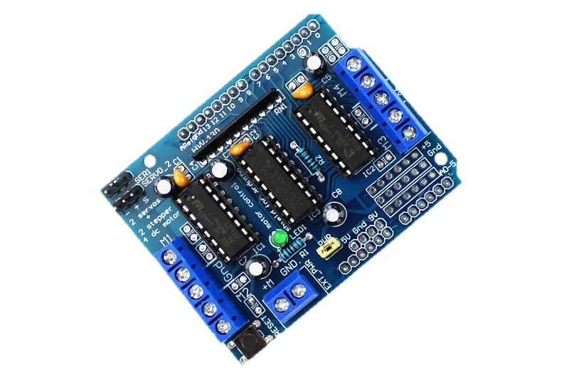
Digital Pins
Motor 4
Motor 1
Ground
Ground
Motor 3
Motor 2
Analog Pins
External Power
Power Pins with Arduino

Slide 3
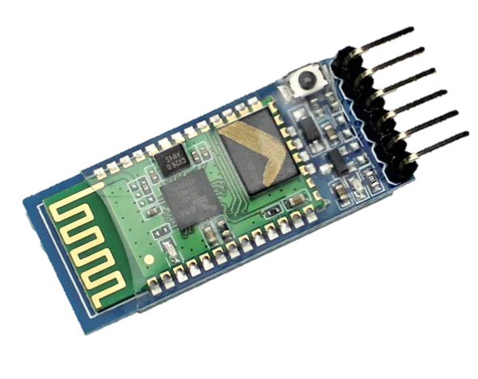

Slide 4
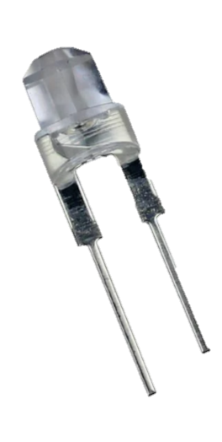
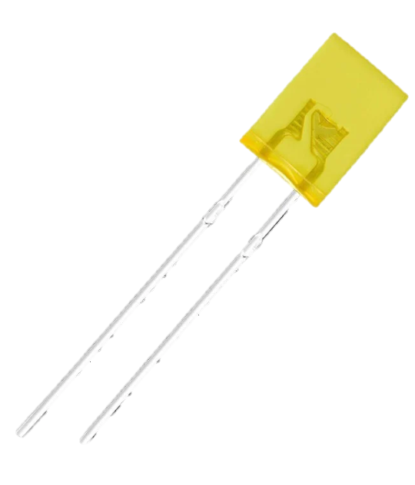
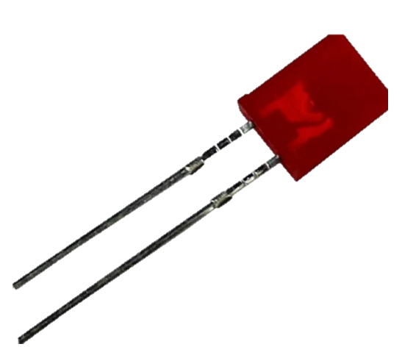

Slide 5
